Slide 1
Structures of Addition and Subtraction

Slide 2
As you enter class:
On a post-it note, write a addition or subtraction word problem.
Totals should be less than 100
Problems should require one step to solve.
When you’re done, place your post-it aside for later.

Slide 3
Objective
Solve, analyze, and generate word problems involving various structures of addition and subtraction and multiple representations.

Slide 4
Task 1: Solve
Work individually to solve the six word problems on the handout.
Include an equation and a drawing/model for each problem.
Notes:
Distribute Task 1 word problems, 1 per candidate

Slide 5
Task 1: Discuss
When you are finished, compare with your table to see the variety of drawings and equations.
Discuss what you would anticipate if you gave these problems to elementary students.

Slide 6
Task 1: Analyze
Work with your group to analyze the student work handouts that were distributed.
Consider:
How do the students’ equations compare with what you wrote?
How do the students’ drawings/models compare with yours?
What strategies is this student using?
Will those strategies always yield accurate results? How do you know?
Notes:
Distribute child’s work for Task 1 (1 per group)

Slide 7
Video excerpts of children solving Task 1 problems
Student work Problem 1
Student work Problem 2
Student work Problem 3
Student work Problem 4
Student work Problem 5
Student work Problem 6
Notes:
You may not have time to watch and discuss all of these. If not, choose 1 or 2 problems from 1-5. Then show Problem 6 since this was not on the child’s written work. Note that Problem 6 is the only problem for which the student writes a subtraction equation.

Slide 8
Activity A
What are some vocabulary terms associated with addition and subtraction?
A + B (addends, summands, terms, sum)
A – B (difference, terms; A = minuend,
B = subtrahend; think “subtract the subtrahend”)

Slide 9
Activity A
Inverse relationship:
If A + B = C, then
C - A = B “Fact Family”
C - B = A
Representations:
C
Bar diagram Number bond or “math mountain”
A B

Slide 10
Activity A
Addition and Subtraction Structures
Puzzle packets include:
Four puzzle templates
Titles (place these first)
Various pieces: Word problems, diagrams, equations
List of discussion questions

Slide 11
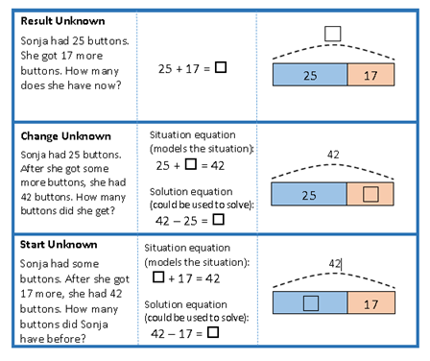
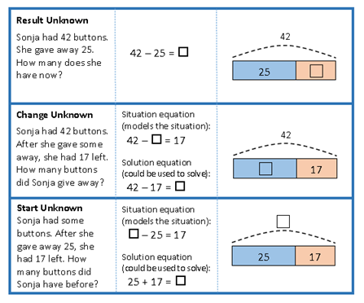
Activity A: Puzzle Key
Add to Problems Take From Problems

Slide 12
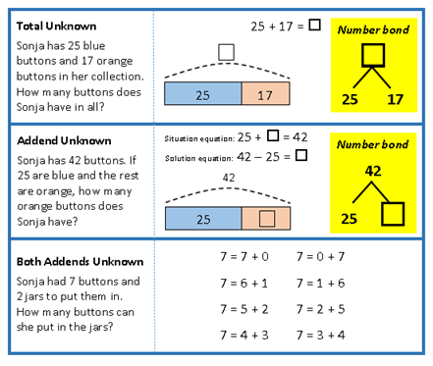
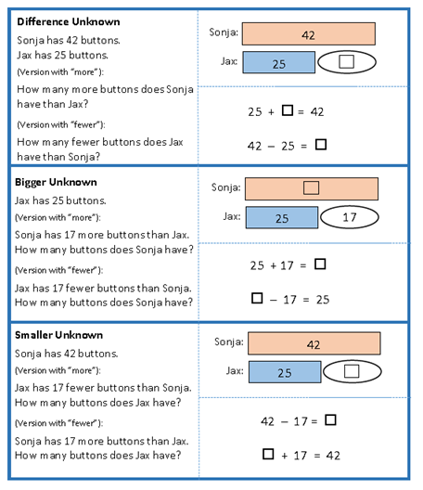
Activity A: Puzzle Key
Put together/Take apart Compare Problems

Slide 13
Activity A: Puzzle Discussion
Which pieces were more difficult to place and why?
How did you decide where to place the “Put-together/Take apart” title? What is the difference between “add to” problems and “put-together/take apart” problems?
Why do some problems have both a “situation equation” and a “solution equation”? What do these terms mean and why are they sometimes different?
How did you decide which stories are compare problems?

Slide 14
Activity A: Puzzle Discussion
5. Why are the diagrams for the compare problems different?
I.e. what are the ovals for?
6. How do you distinguish between bigger unknown and
smaller unknown compare problems?
7. Would there be a difference between 23 + ? = 41 and
? + 23 = 41 if these were situation equations for a
problem?
8. Why might it be important for teachers to know these
types of problems?

Slide 15
Revisiting the Launch Activity
Place your post-it note in the location that best fits the type of problem you wrote.
 | Add to | Take away | Put together | Take apart | Comparison
Total unknown
Change unknown
Start unknown
Notes:
Questions to pose to candidates after post-its are placed on table:
What do you notice about the word problems our class generated?
Why might this matter for our teaching of addition and subtraction to chidren?

Slide 16
Task 2: Generating word problem structures in context
For this task, you’ll be working in 12 groups.
You’ll find your group number in the table on page one of Task 2.
Decide on a context that is familiar to everyone in the group. This could be a book, television show, movie, etc.
After you’ve decided on a context and recorded it in the table, go to the second page of Task 2 and find your group number. Wherever you see your group number, work with your group to generate a word problem of that structure. Your word problem should use the setting, characters, etc. relating to the context you selected.
Notes:
Decide, in advance, how you want to group students. There are 12 groups so small classes may work individually. Larger classes may work in pairs or groups of 2-3.
Task 2 is in Google Docs. Decide in advance how to share this with students. Some options include: making a QR code, emailing the link, posting on course webpage.

Slide 17
Task 2: Analyzing word problems
Take a moment to read the word problems that everyone wrote.
What questions do you have about any of the problems?
Are there any problems that you think are not accurate for the structure assigned?

Slide 18
Activity B: Structures Error Analysis
The handout contains incorrect story problems written in response to questions A-C (in bold font) on a test
In the space on the worksheet, identify what is incorrect about the response (do not rewrite the problem)
Use the Stand-Up-Hand-Up-Pair-Up cooperative learning strategy
Early finishers complete the last problem on the worksheet

Slide 19
Activity B: Discussion
Which errors were the most difficult to identify and why?
The response to #2 has the correct equation--why is it incorrect?
The response in #8 is solved by addition, as required--why is it incorrect?
Is anyone willing to share their story problem for the last question?

Slide 20
Wrapping up
Review the problems you solved for Task 1 and discuss with a partner:
What did you know and understand about these problems at the beginning of the class?
What do you know and understand about these problems after this class?
How will your understanding help you better support students in learning this content?

Slide 21
Exit Ticket
Please complete the exit ticket before leaving.
Notes:
Hand out the exit ticket and collect as students are leaving class.

